Slide 1
Dog Treat Dispenser - The Blueberry Jam
Jake, Jude & Shanmugam

Slide 2
Problem Overview
Ryan, a spinal cord injury survivor, has limited mobility and uses a motorized wheelchair.
He enjoys outdoor activities with his service dog, Oliver, but has difficulty managing and dispensing dog treats independently.
Current treat storage methods are inconvenient and prone to spills.
There is a need for a portable, wheelchair-compatible device that allows Ryan to easily store, carry, and dispense dog treats in a controlled, accessible way.

Slide 3
Critical User & Engineering Requirements
User Need | Engineering Requirement
Ryan should be able to use wheelchair comfortably and unobstructed. | Width is maximum 6 cm greater than width of arm rest
The device dispenses to his hand | Falls within a 3 inch diameter area repeatedly
Device needs to be easily activated | Can be done in two steps or less and with 10N or less
Device has adequate capacity for a whole day | At least a half cup of treats can be stored and dispensed without refilling
Notes:
*These are our highest priority needs/requirements - there are many more

Slide 4
Secondary User & Engineering Requirements
User Need | Engineering Requirement
The device is cleanable | Material can withstand water/soap/abrasion over the course of time Plastics used are number 1, 2, 4, 5 or 7
Device is aesthetically pleasing | The color matches the wheelchair 8/10 people rate as aesthetically pleasing
Device can be easily attached and detached from the wheelchair | Can be detached/attached in two steps or less.
The device is easily fillable/refillable | Lid detaches in one step

Slide 5
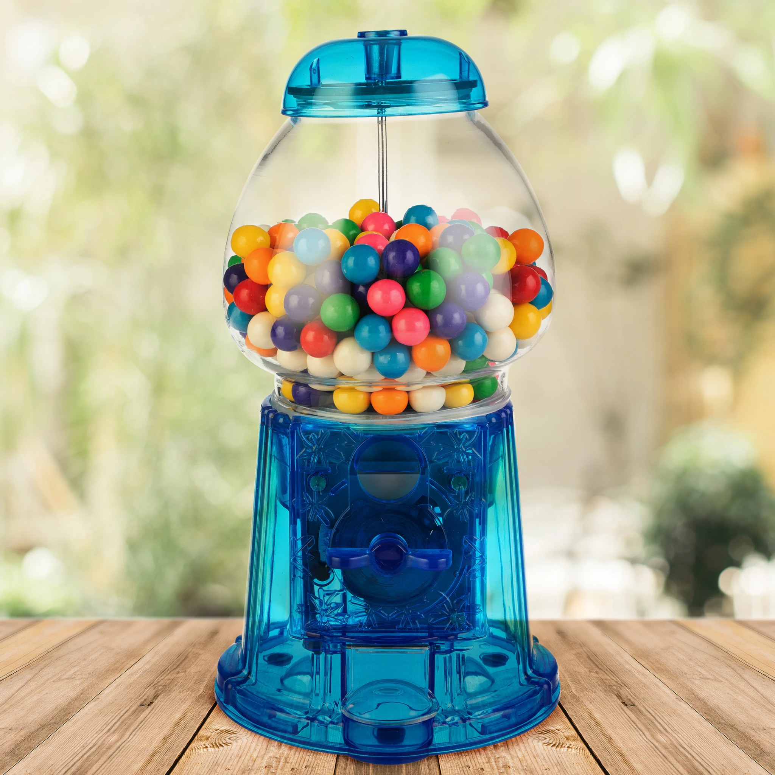
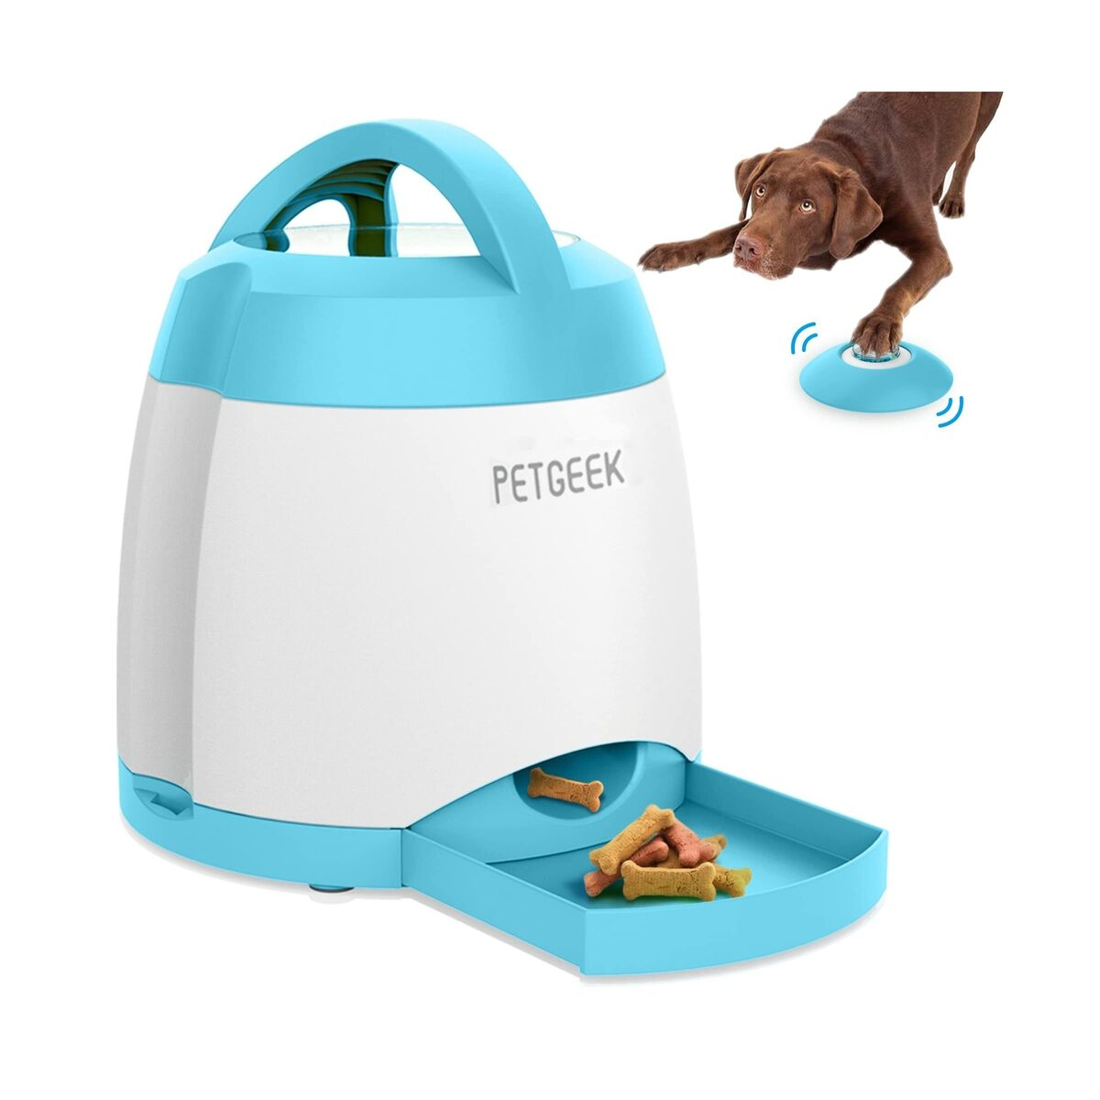
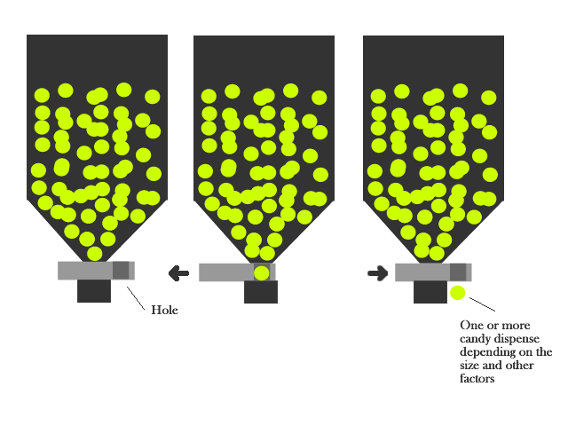
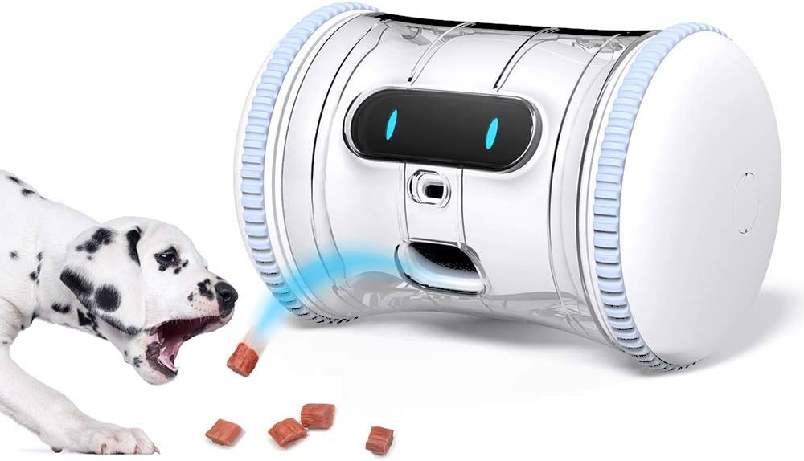
Existing Products in the Market

Slide 6
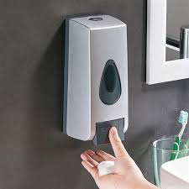
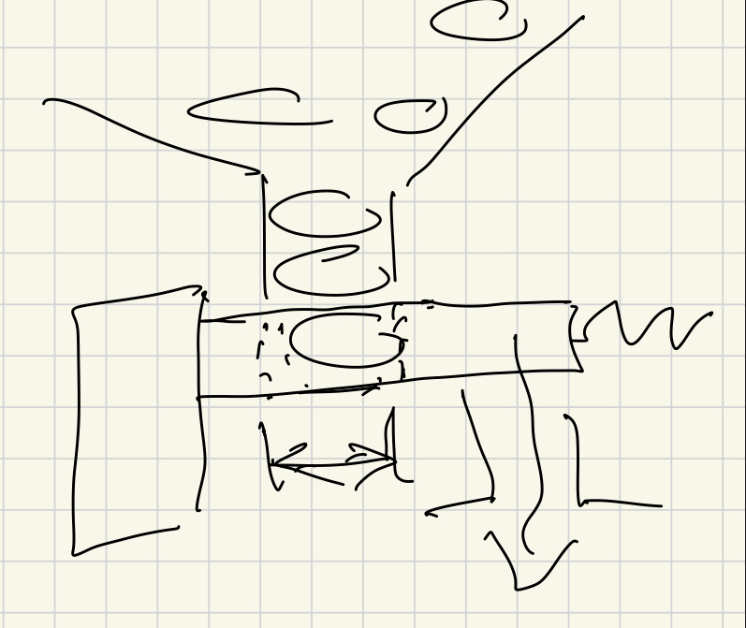
Prototype #1: Button Activated
Ideation:
Candy dispenser mechanism Soap dispenser ergonomics Sketch

Slide 7
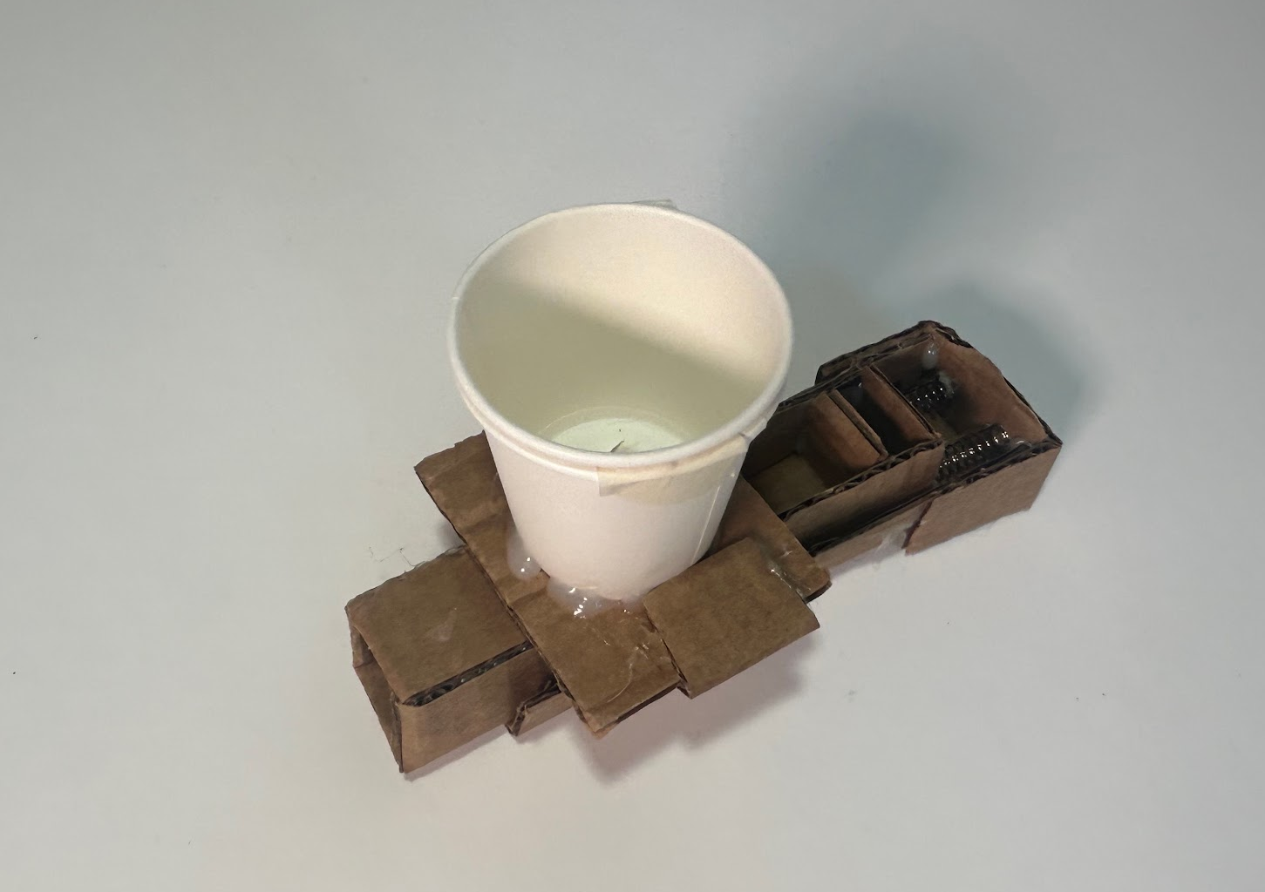
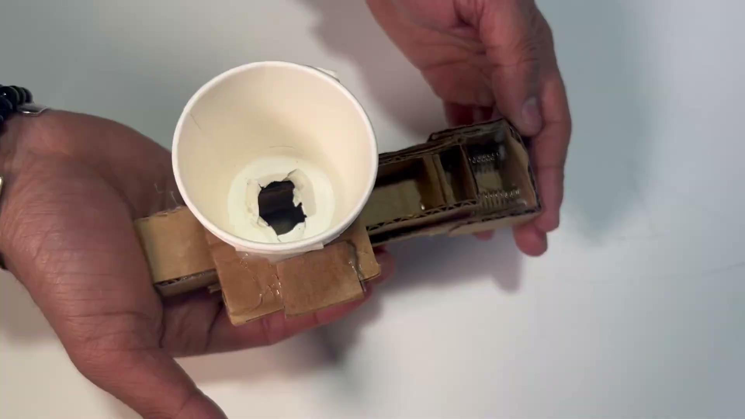
Prototype #1: Button Activated
Pros:
Requires minimal dexterity
Single motion
Dispenses directly to hand
Cons:
Jams
Several moving parts (cleanability)
Requires some force from the user

Slide 8
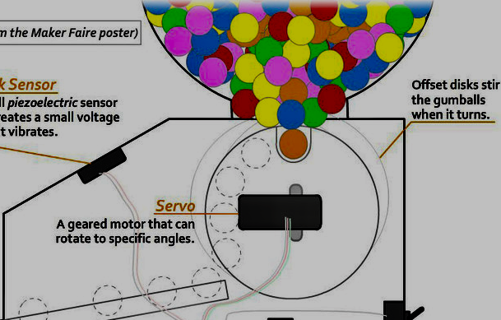
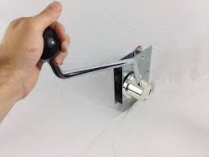
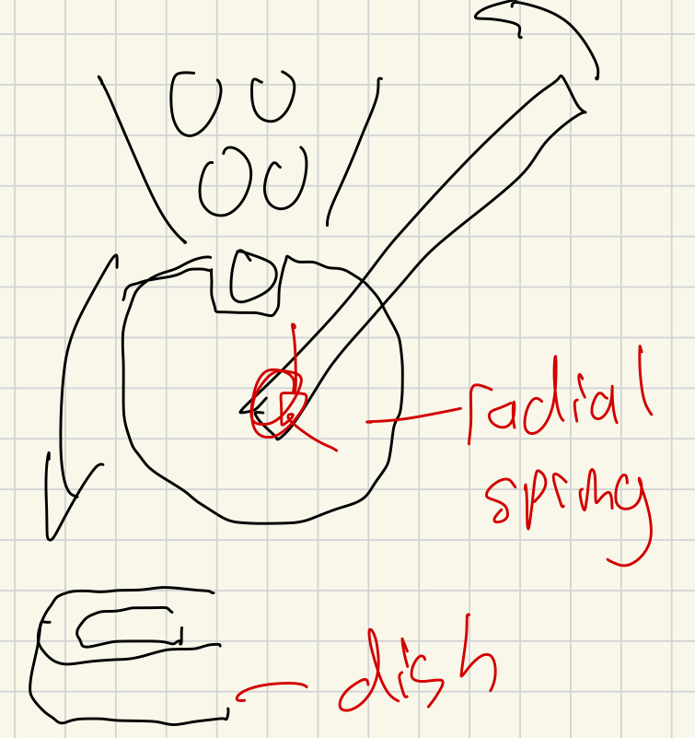
Prototype #1: Lever Activated
Ideation:
Gumball machine mechanism Lever driven Sketch

Slide 9
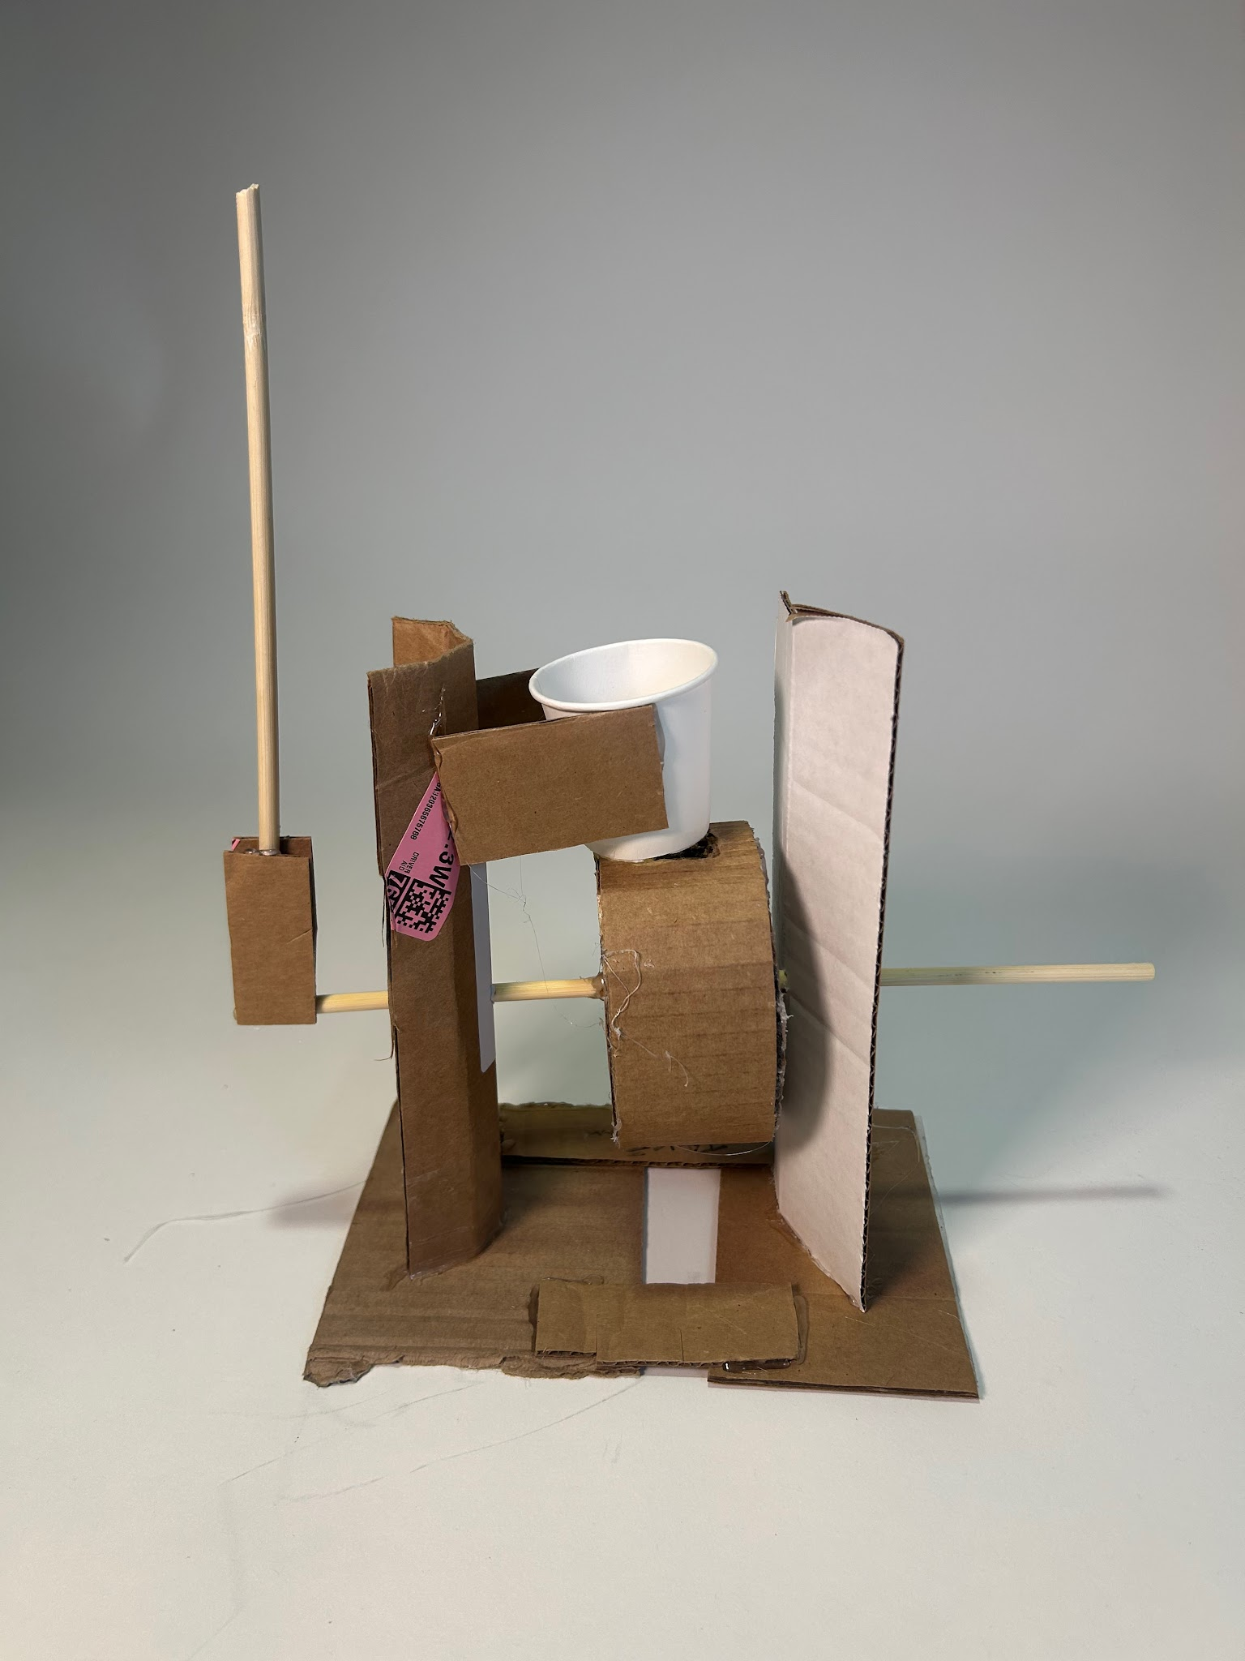
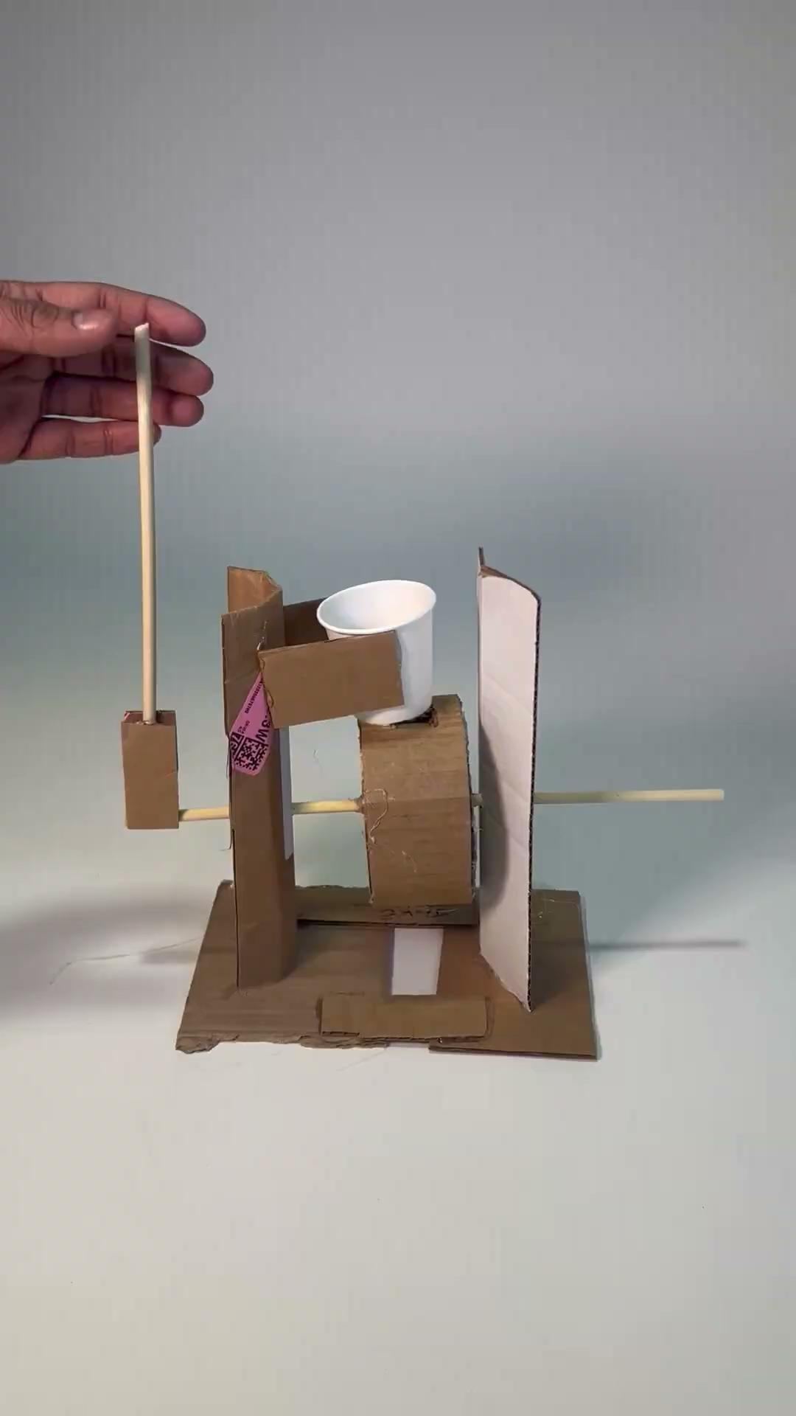
Prototype #2: Lever Activated
Pros:
Minimal dexterity and force input due to lever arm
Few jams
Single motion
Cons:
Requires 2 hands
Larger volume (harder to attach)
Several moving parts (cleanability)

Slide 10
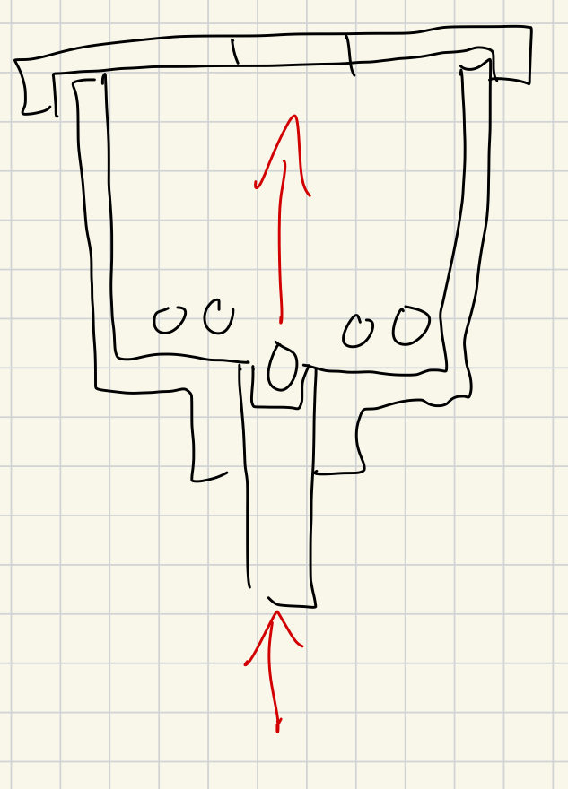
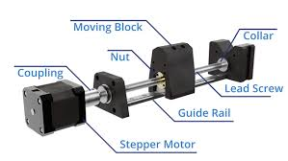
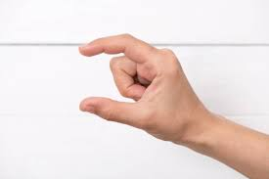
Prototype #3: Plunger
Ideation:
Possibly lead screw driven? Prioritize pinching motion Sketch

Slide 11
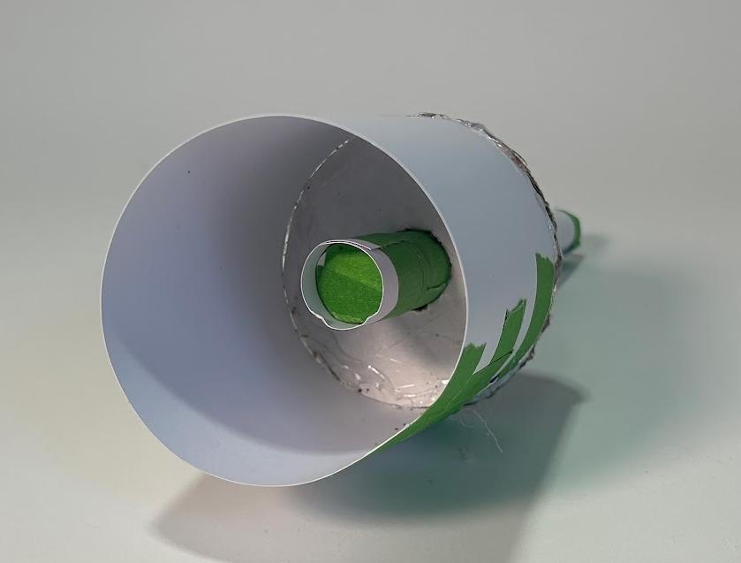
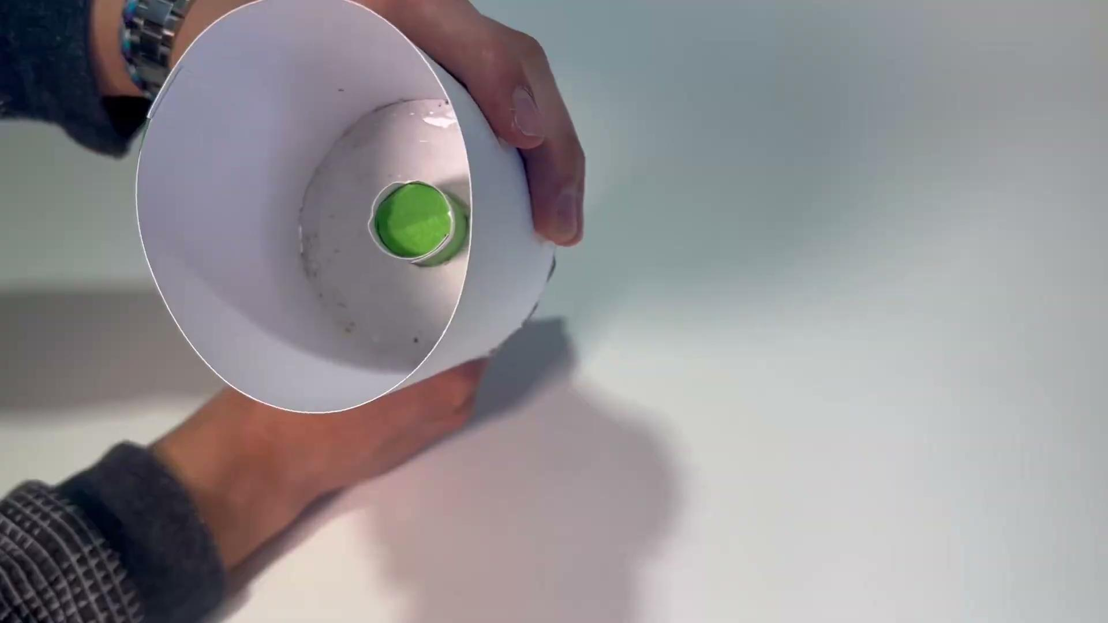
Prototype #3: Plunger
Pros:
User can pinch treat with thumb and forefinger (as requested)
Few parts
Cons:
Long travel distance (possible error)
Multiple motions
Requires some dexterity
Goofy

Slide 12
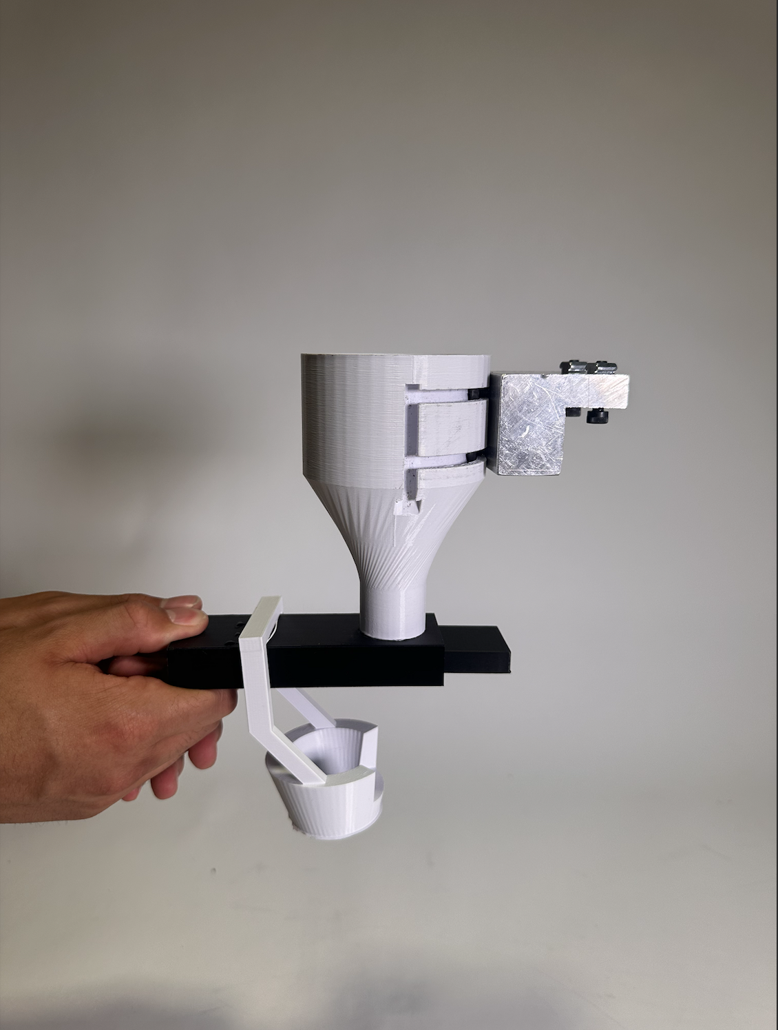
Medium Fidelity Prototype #1
Pros: Easy to activate, collect and clean
Cons: Jams!
This metal mount connects the wheelchair armrest to our funnel
Treat Basket

Slide 13
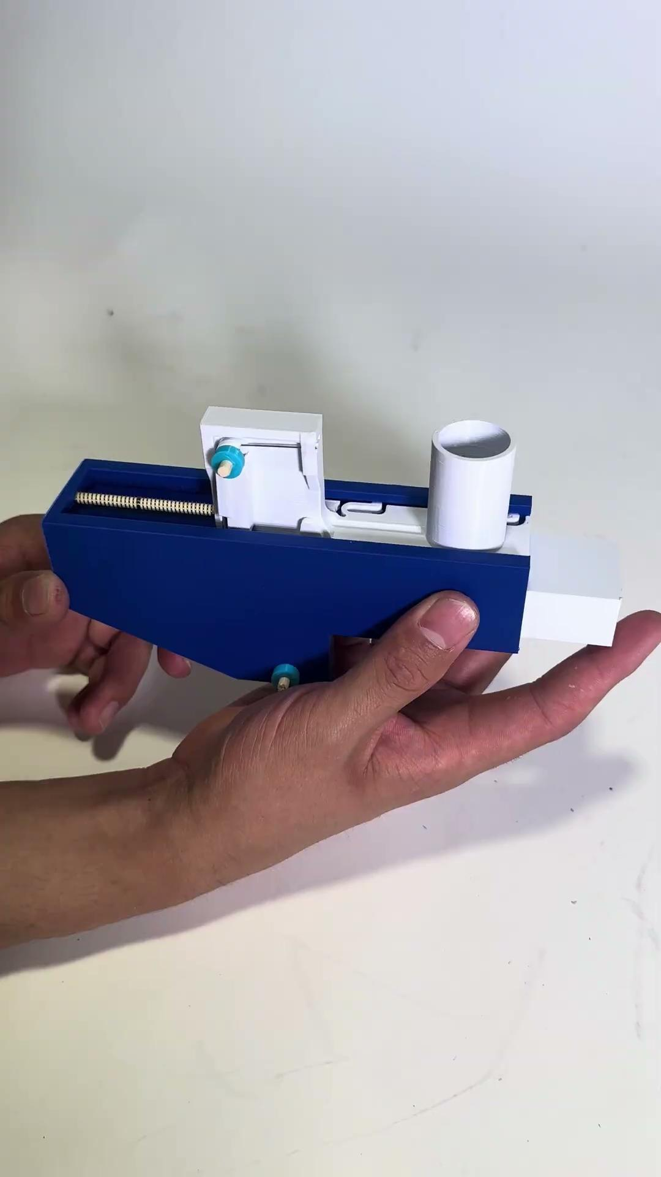
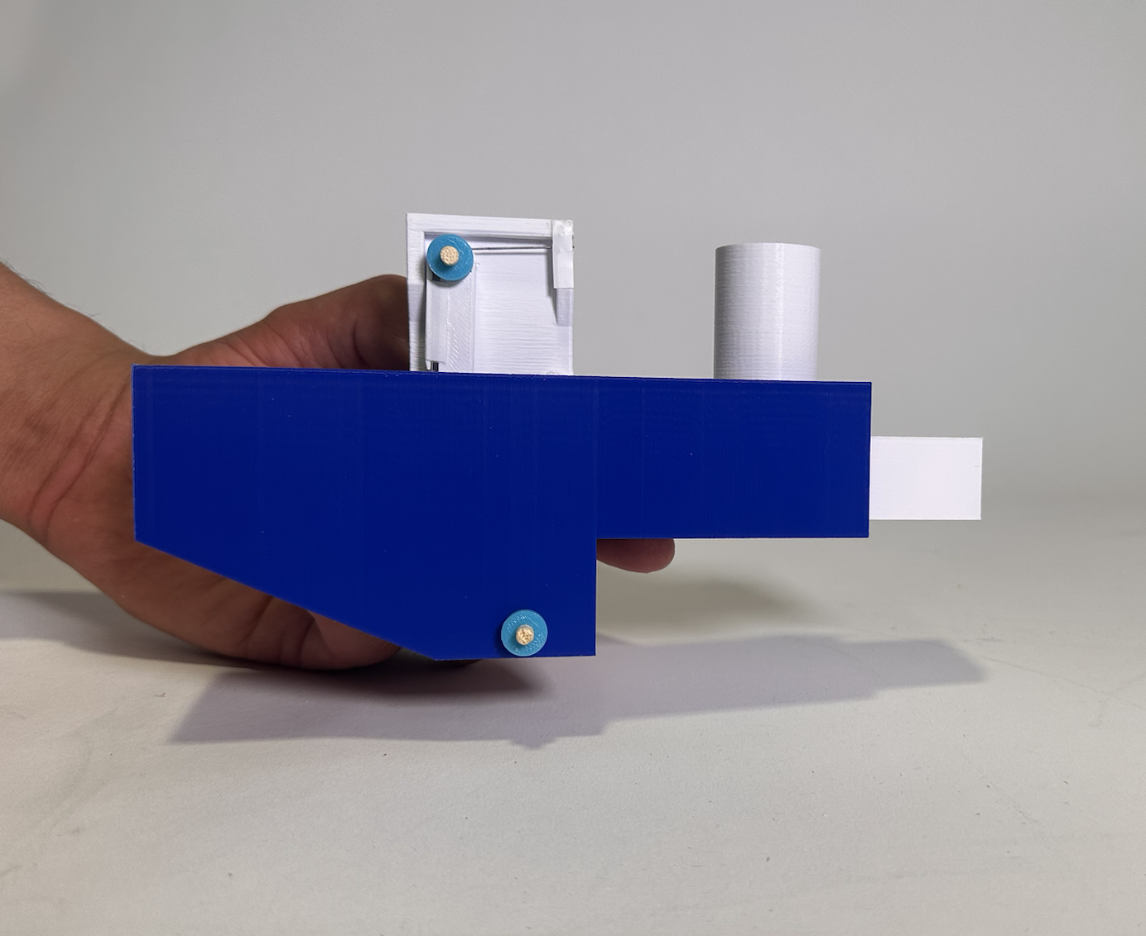
Medium Fidelity 2: The Anti Jammer
Pros: Counter-acts jamming effect
Cons: More complex mechanism, harder to clean, greater space requirements
Funnel now is on a separate track, allowing to move, generating a “shake” with each button press

Slide 14
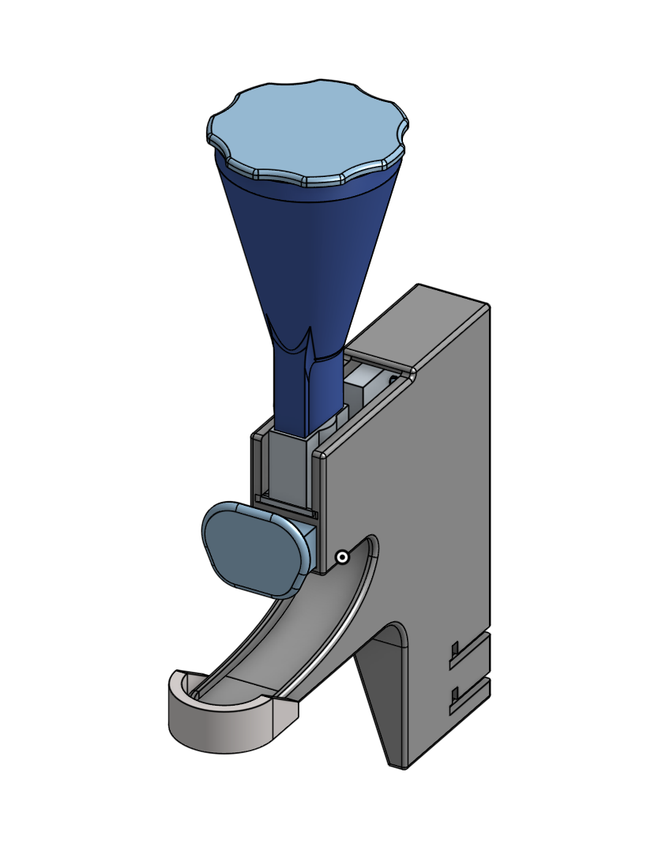

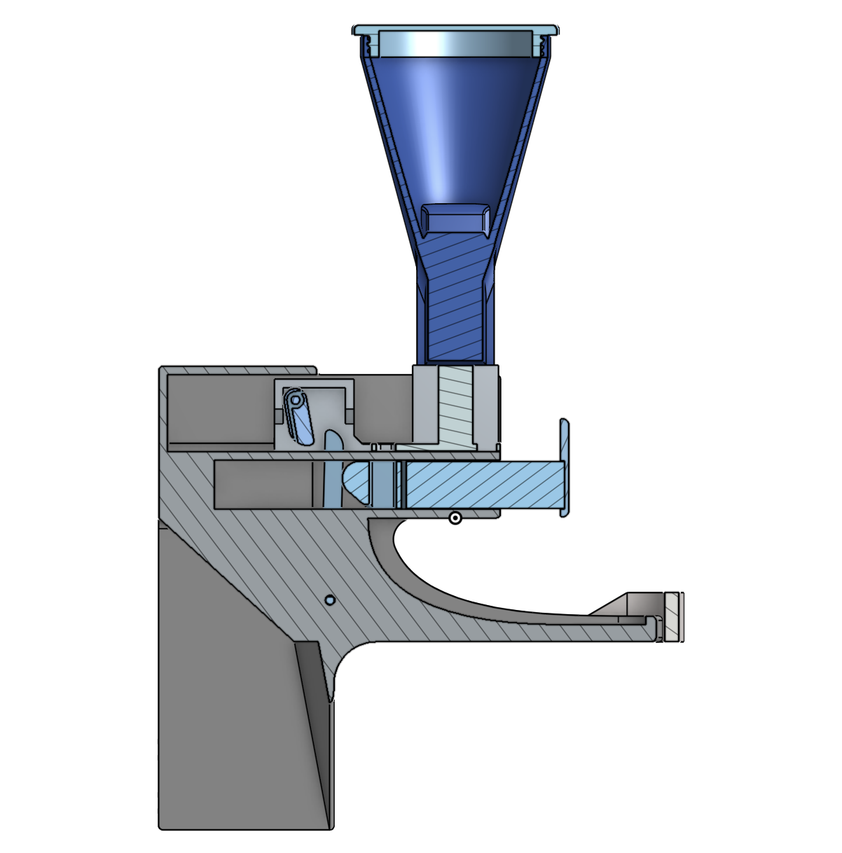
Current Model

Slide 15
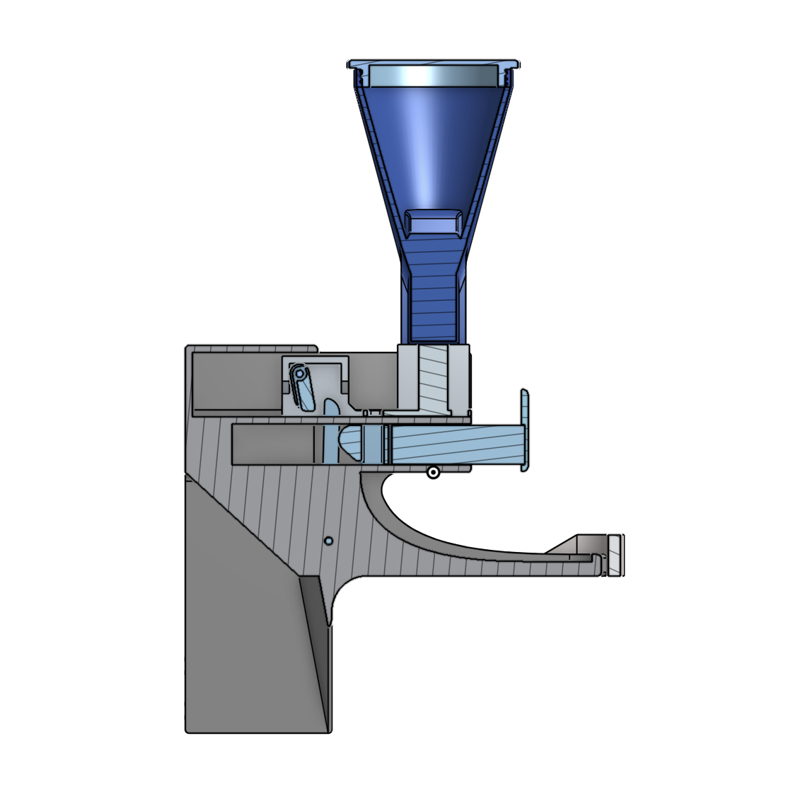
When these holes line up, only one treat will fall through.

Slide 16
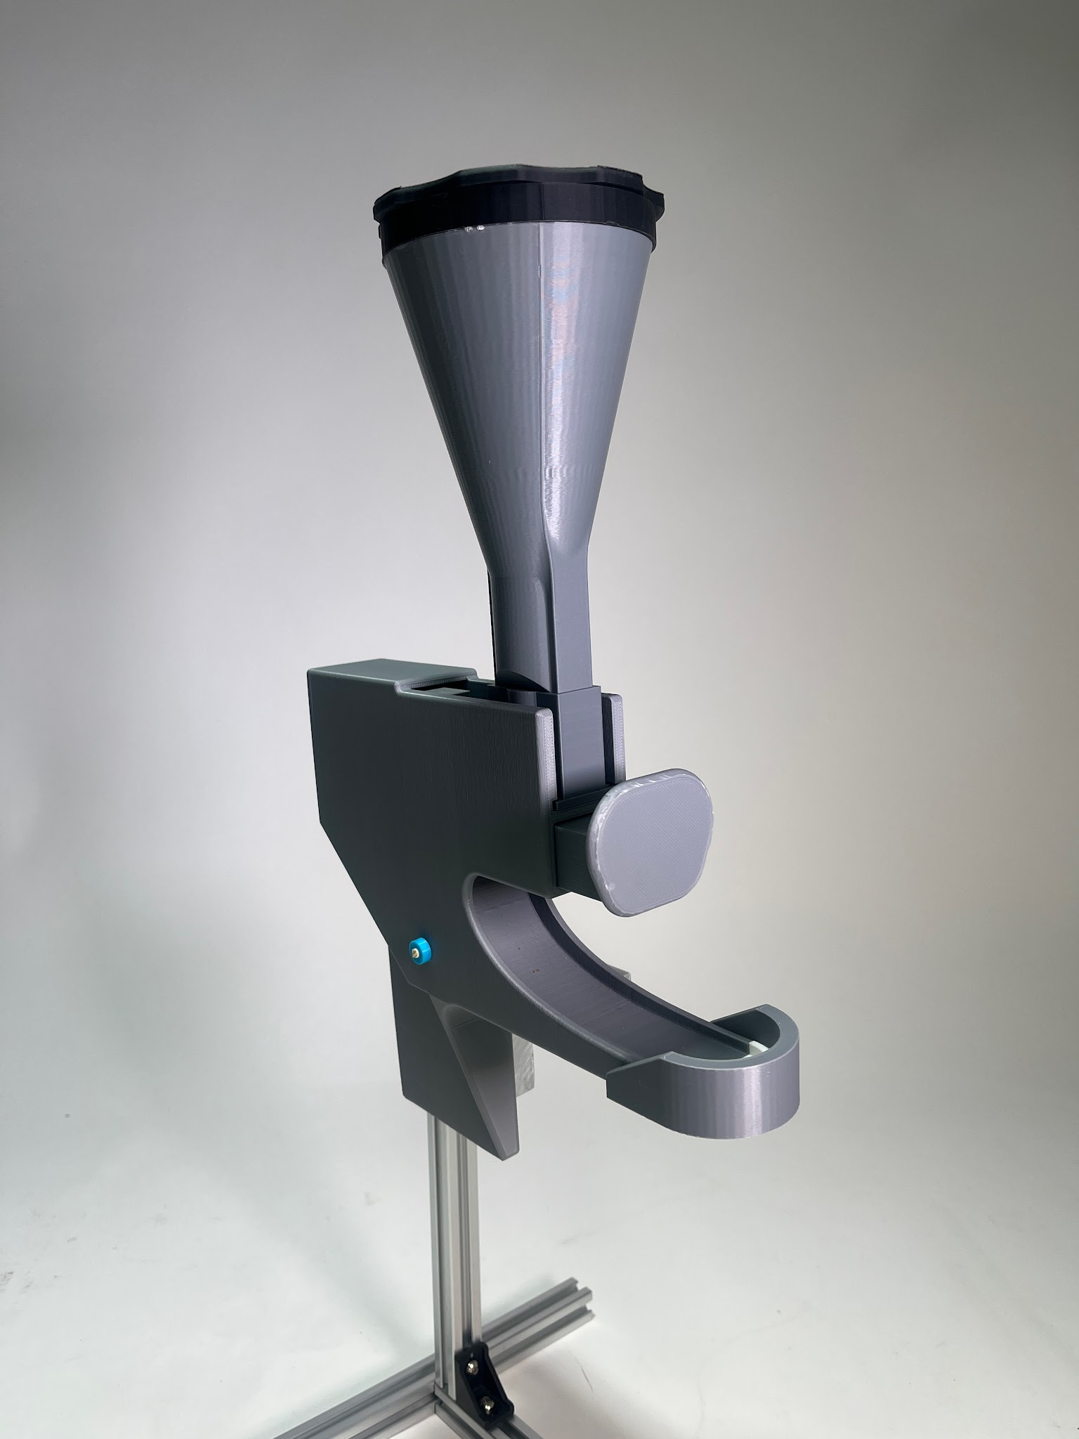
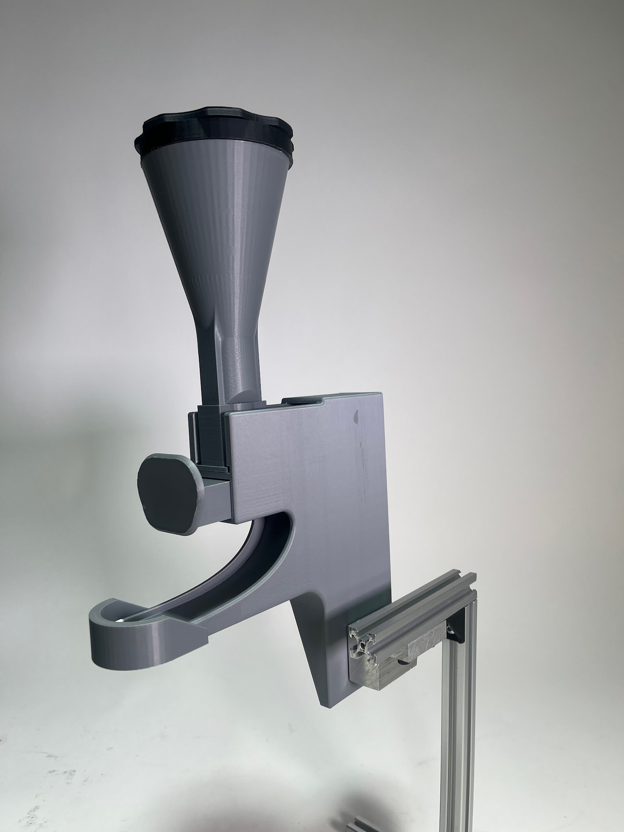

Slide 17
Future Directions
Ensure materials are food-safe, durable, and rust/water resistant
Improve form factor, make entire mechanism more efficient and smaller
Increase treat storage capacity
Improve tolerances for mounting mechanism to improve the process of sliding it in and out
Improve aesthetics as per Ryan’s preferences
Improve hopper geometry to further decrease jams

